Slide 1
Spawn an Online Game with Blazor & .NET 9
In under 60 minutes
@Solution2

Slide 2
Agenda
What is possible?
Game design
Building the game
Let’s play

Slide 3



Luke Parker
Full Stack Engineer
Building with Blazor for 6 years
Commercially in Production for 3 years
Playing games for way too long, or not long enough!
Hona
lukeparker.dev

Slide 4
“The measure of intelligence is the ability to change” - Albert Einstein

Slide 5
Agenda
What is possible?
Game design
Building the game
Let’s play

Slide 6
Blazor – What is it?
Think with: Component model
Write with: Mixed C#, HTML & Razor markup
Render with: Static SSR, Interactive SSR, CSR (with WASM), Interactive Auto (server, then client)
Notes:
In fact, as early as 2015, Jimmy was talking about SOLID Architecture which is essentially the same thing. It had a few key points (from his slides):
The key points of the SOLID architecture were really applying the principals to achieve a highly cohesive codebase in regard to the Domain specific code (SRP, ISP).
The Domain specific code was then extended (OCP) via cross-cutting concerns - like authentication, authorization & generic logging.
A lot of the outcomes from this talk to me, was allowing a simpler architecture for what matters most - the Domain. The most important thing in software, is that it works. The architecture that allows you to deliver features quickly, is the best architecture for you.

Slide 7
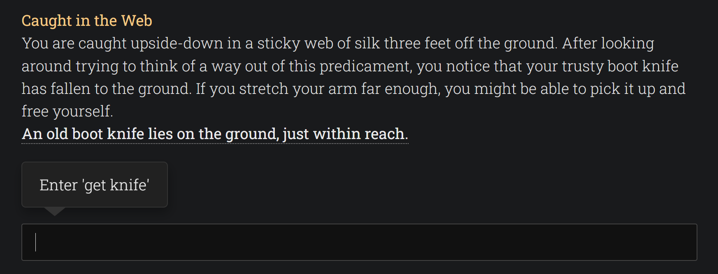
https://writtenrealms.com/

Slide 8
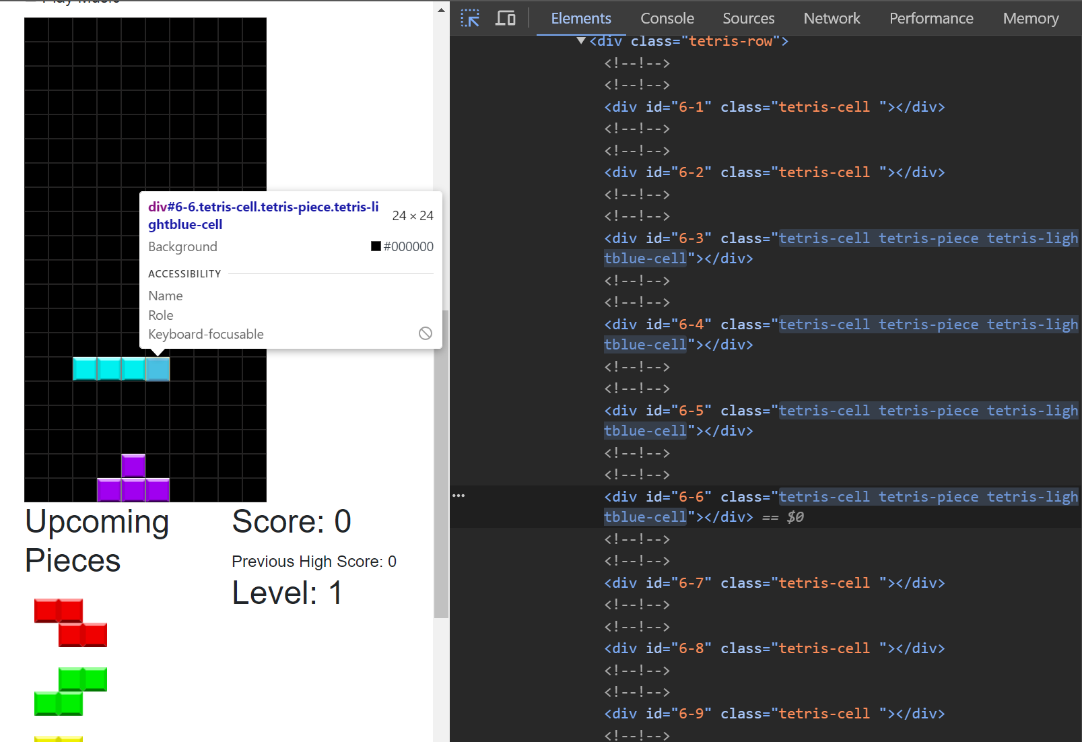
https://blazorgames.net/tetris

Slide 9
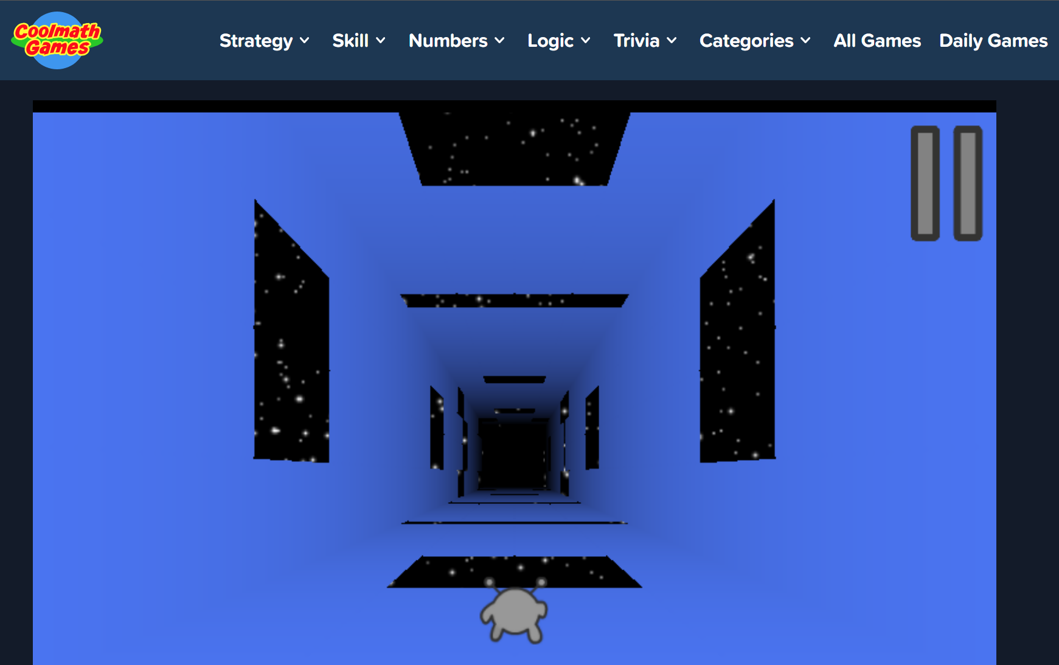
https://coolmathgames.com/0-run-3

Slide 10
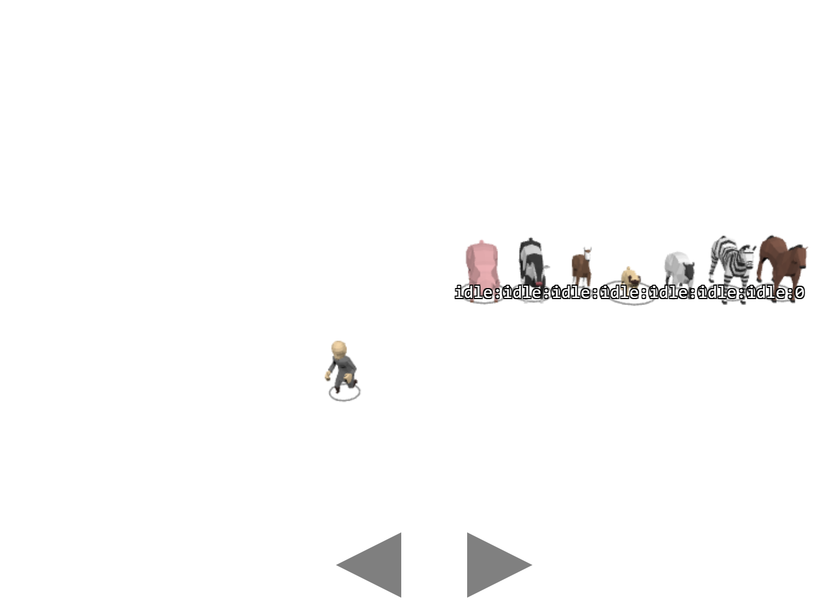
https://threejs.org/manual/examples/game-conga-line.html

Slide 11
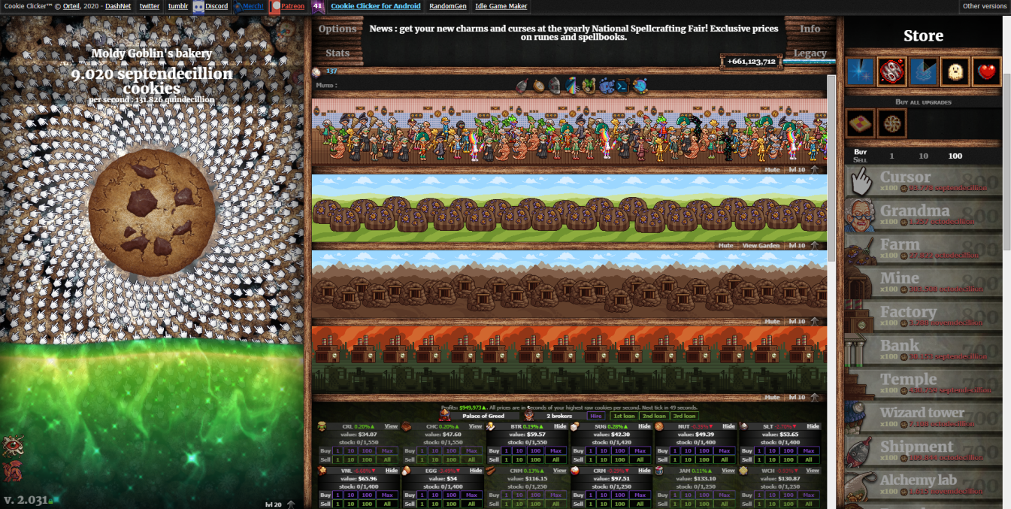
https://orteil.dashnet.org/cookieclicker/

Slide 12
Agenda
What is possible?
Game design
Building the game
Let’s play

Slide 13
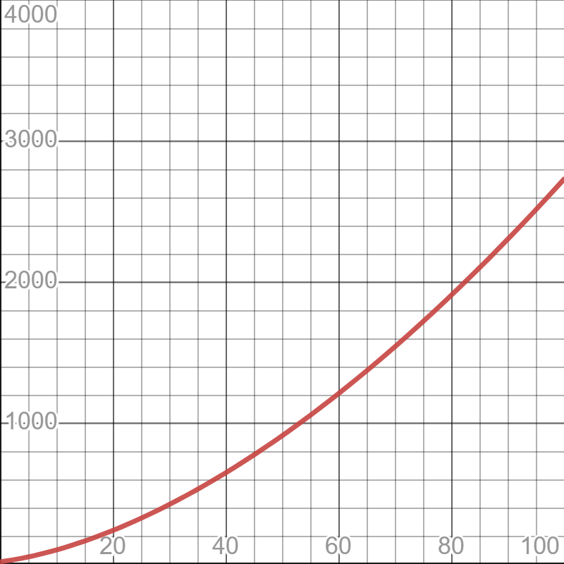
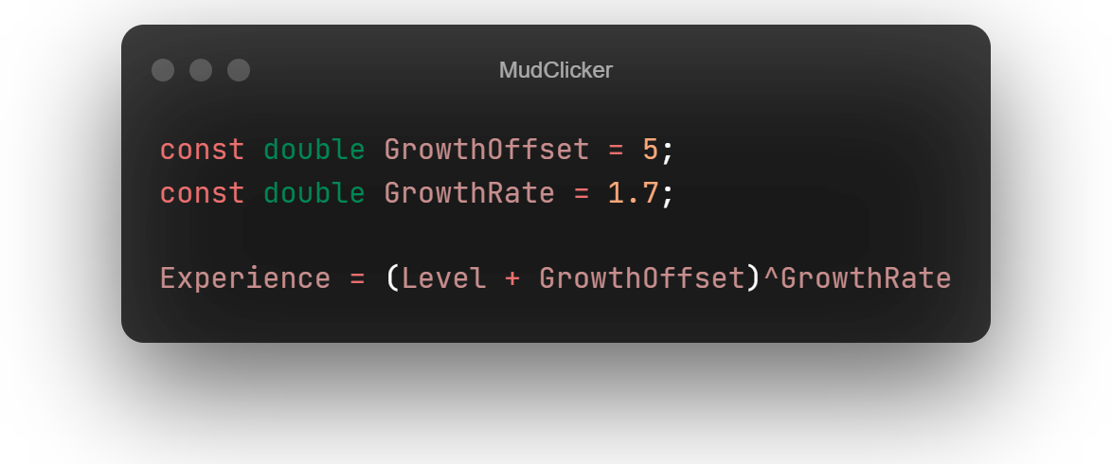
Growth Curve

Slide 14
Gameplay loop
Click
Wait
Numbers go up!

Slide 15
Demo
dotnet new blazor --interactivity WebAssembly --empty

Slide 16

Play together
The clicker game
game.lukeparker.dev

Slide 17
Resources
https://github.com/Hona/BlazorClickerGame
https://github.com/Hona/BlazorCanvasWithFriends
https://github.com/exceptionnotfound/BlazorGames
https://game.lukeparker.dev

Slide 18

Presentation & links

Slide 19
Thank you!
Any questions?

Slide 20
Branding – Cheat Sheet
Typography
Color Guide
Headings: JetBrains Mono Thin
Body: Open Sans
Primary: #EF476F
Secondary: #06D6A0
Tertiary: #FFD166
Body: #FFFFFF
Background: #192E39
Accent Background: #26547C
Surface: #1E3B4A

